Slide 1
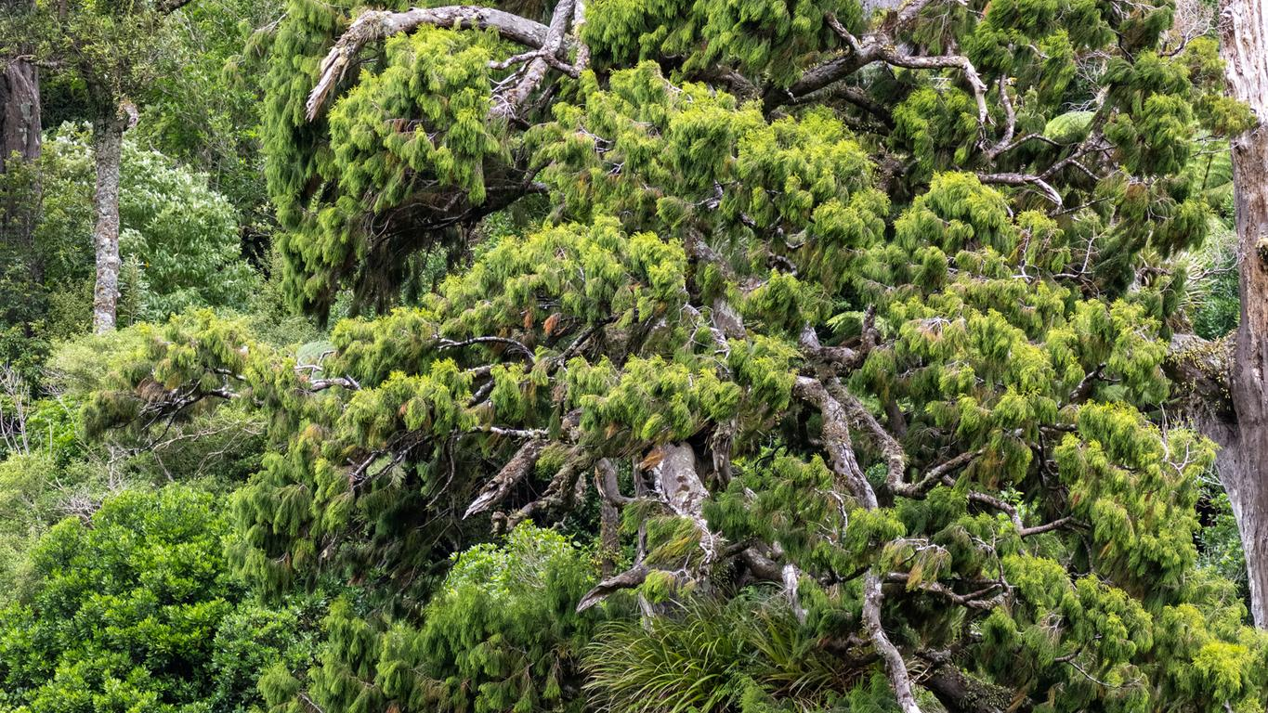
What is sustainable open source?
Richard Littauer - http://richard.social SustainOSS - https://sustainoss.org
Rimu https://www.inaturalist.org/observations/198921399

Slide 2
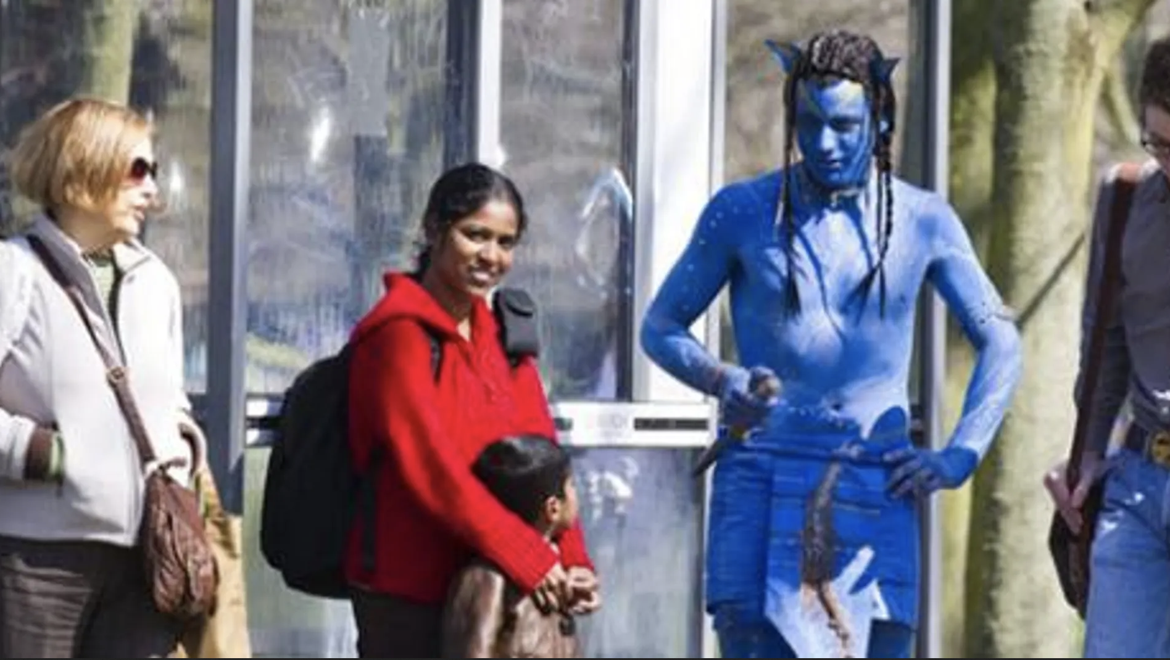
Who is this Richard Littauer, anyway
Linguist and Latin tutor
Software developer
"Community manager"
Worked for: Hipcamp, MIT, Johns Hopkins, Protocol Labs, the OSI, Open Source Collective, the Digital Infrastructure Fund…
Currently: SustainOSS
Source not given

Slide 3
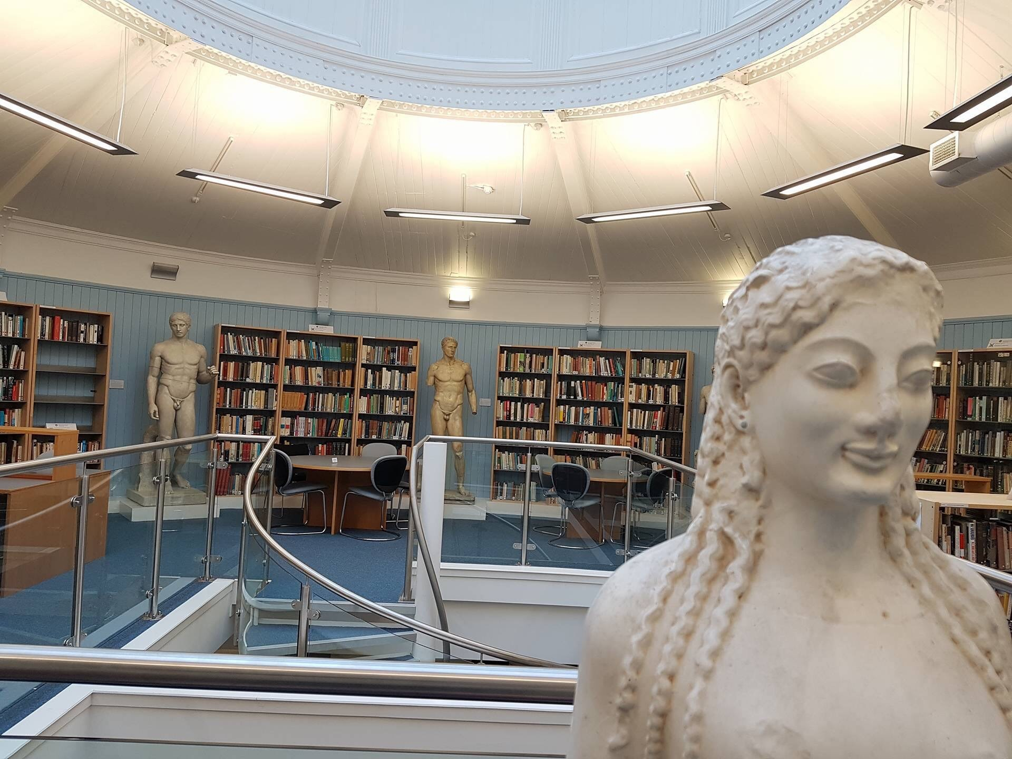
Richard, the Librarian
University of Edinburgh Classics Library
Sciffy Library
North Branch Nature Center
Johns Hopkins University
https://libraryblogs.is.ed.ac.uk/hcalibrarian/2017/11/15/hca-student-research-rooms/

Slide 4
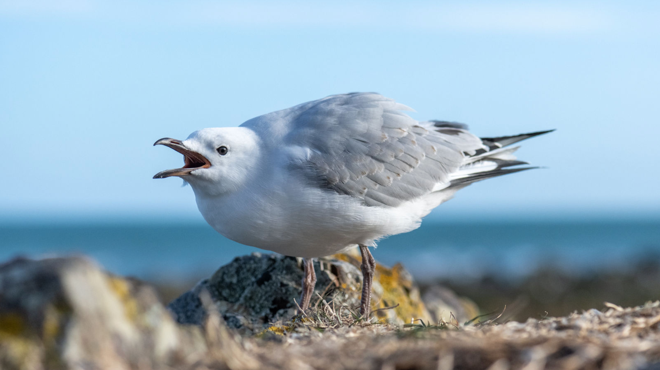
Also a PhD student
Silver Gull https://burntfencreativellc.pixieset.com/newzealand/
Source not given

Slide 5
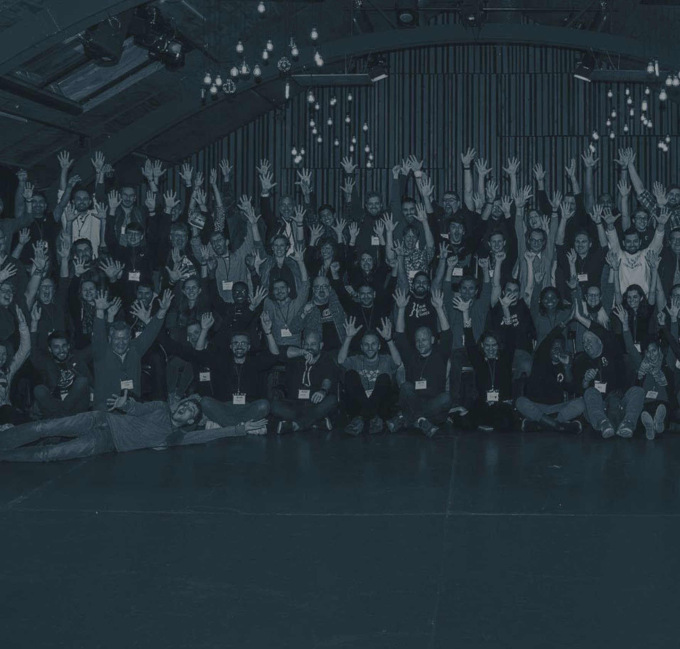
What is SustainOSS?
A community!
Conferences
Working groups
Academia, DEI, Design, Governance, &c.
Podcasts

Slide 6
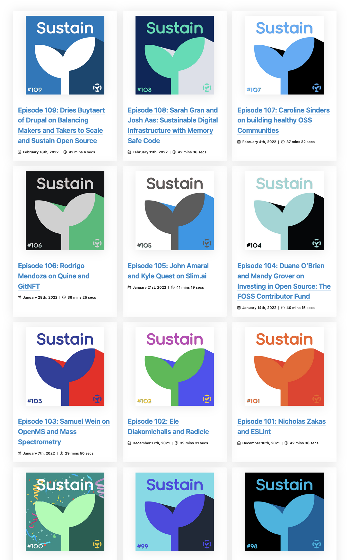
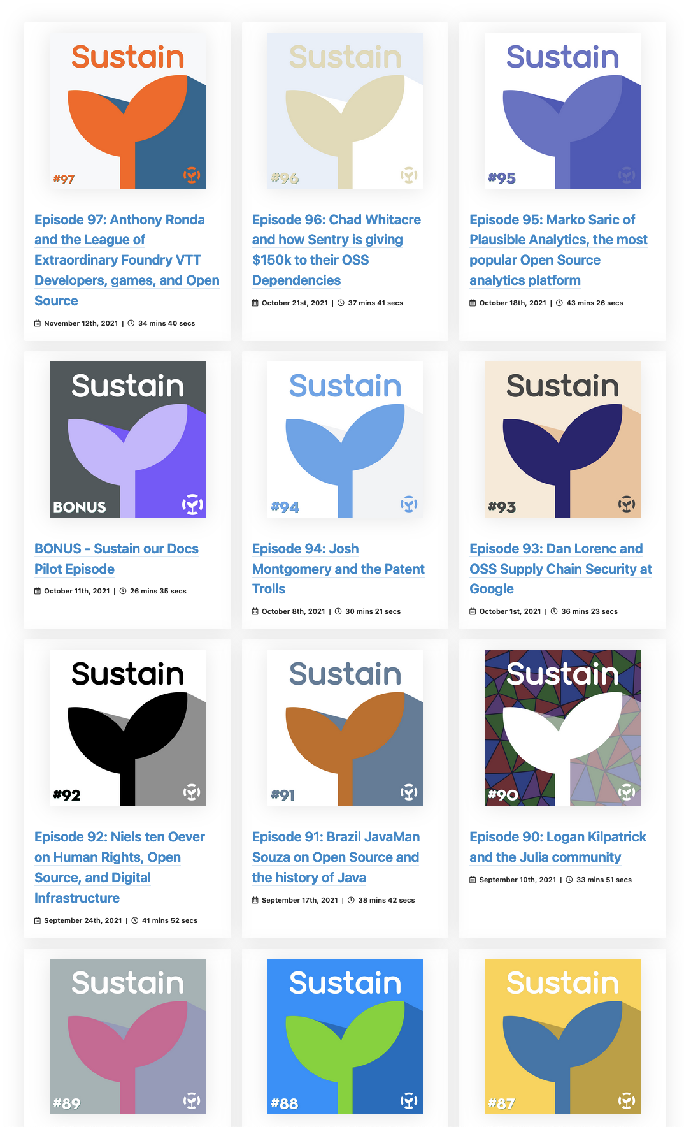
SustainOSS Podcast
Over 300 podcasts
Hundreds of guests
Mostly about open source

Slide 7
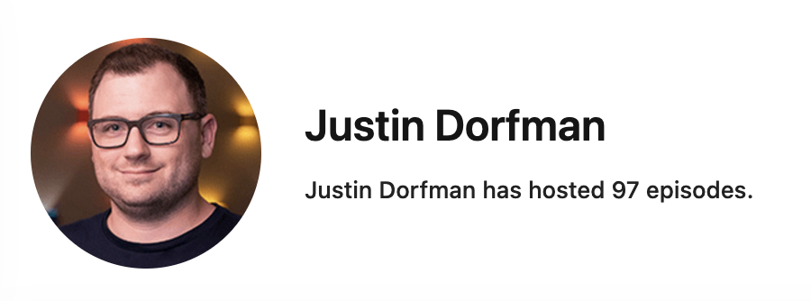
"Sustainers"
The individual or organization who is concerned with the current state and future of highly-used and impactful open source projects.
Notes:
This doesn't get to the core of what sustaining open source would mean, it just talks about concern for the state or future, and limits its scope.

Slide 8
What we're going to cover
What sustainable means in various contexts
What to hear instead
What is "open source"
Why this is hard
What comes after definitions?

Slide 9
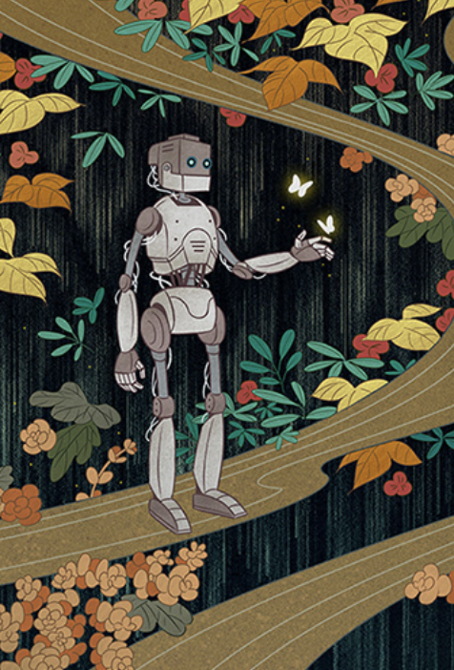
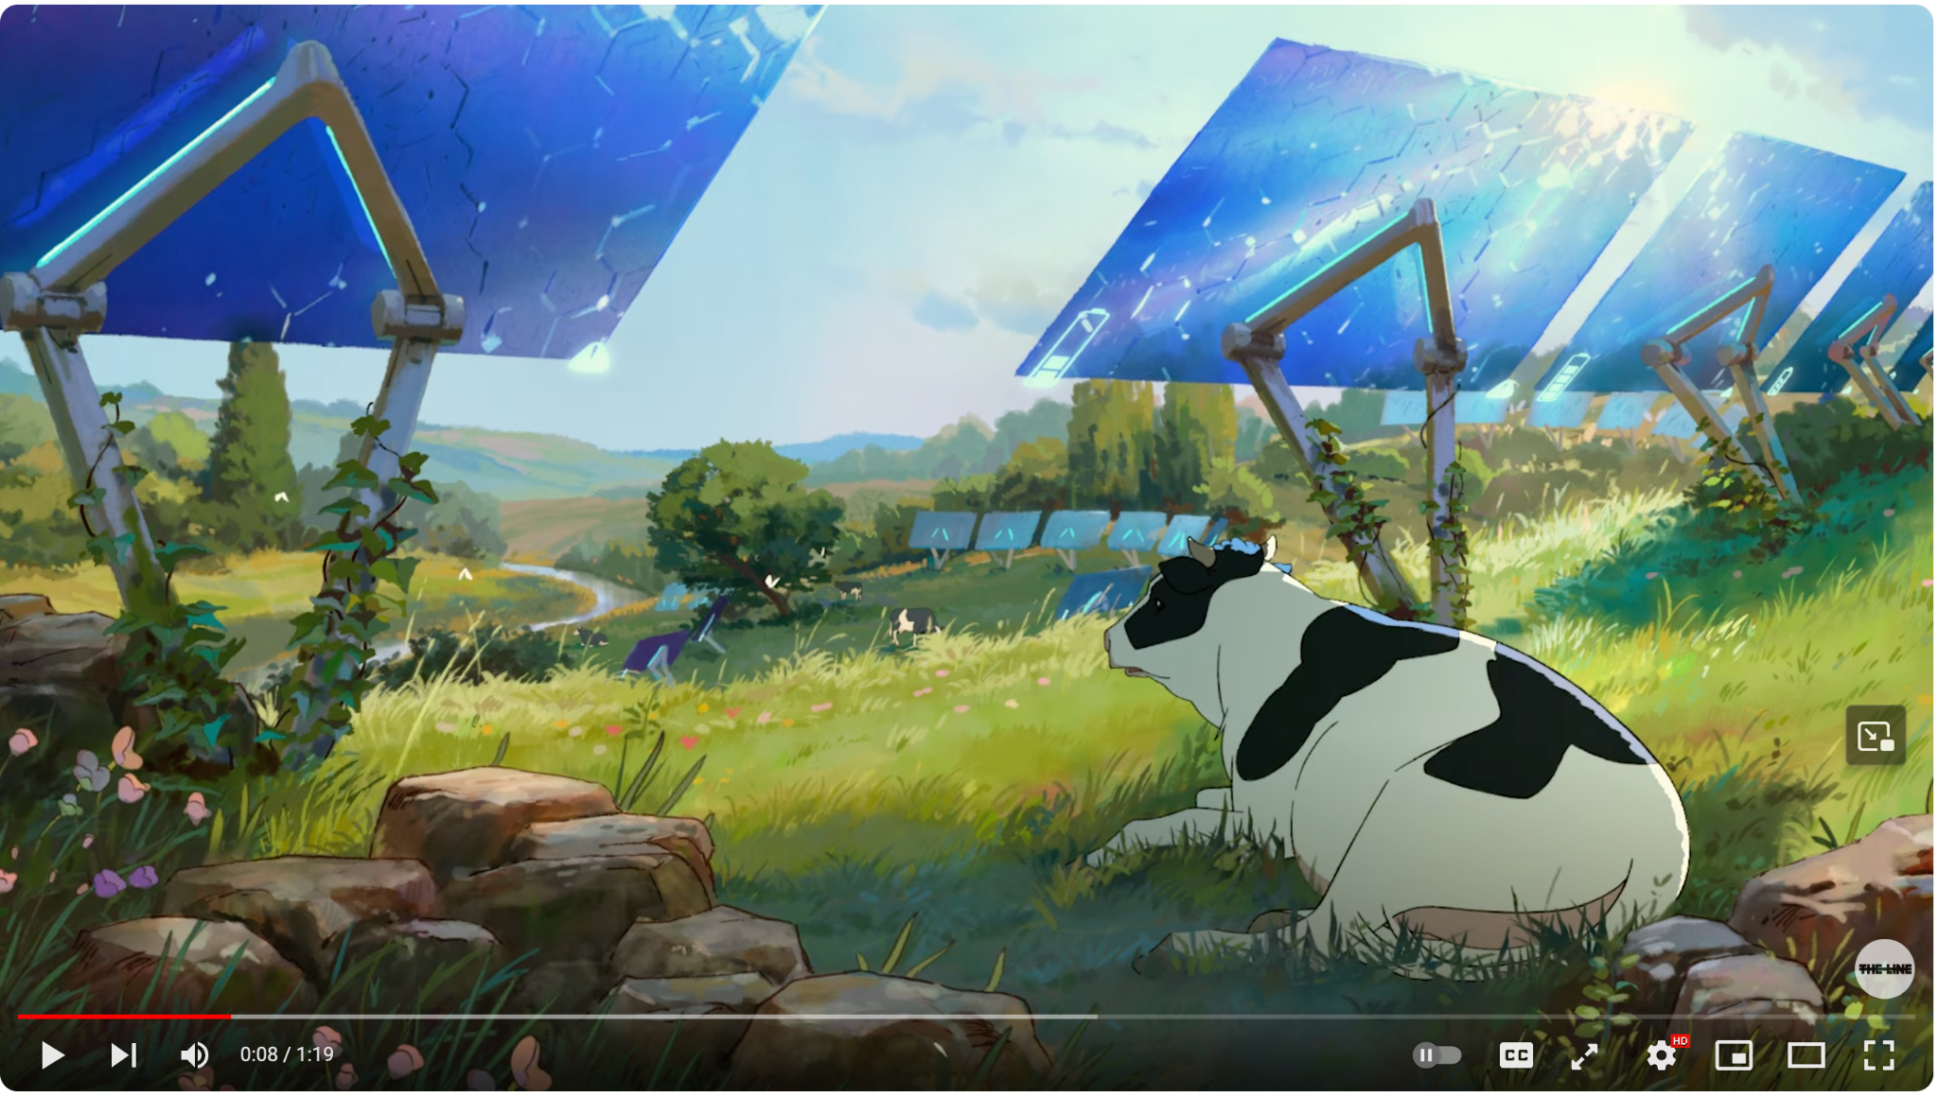
What is Sustainability?
https://www.behance.net/gallery/127556565/Book-Cover-A-MONK-AND-ROBOT-BOOK
"Dear Alice" https://www.youtube.com/watch?v=z-Ng5ZvrDm4

Slide 10
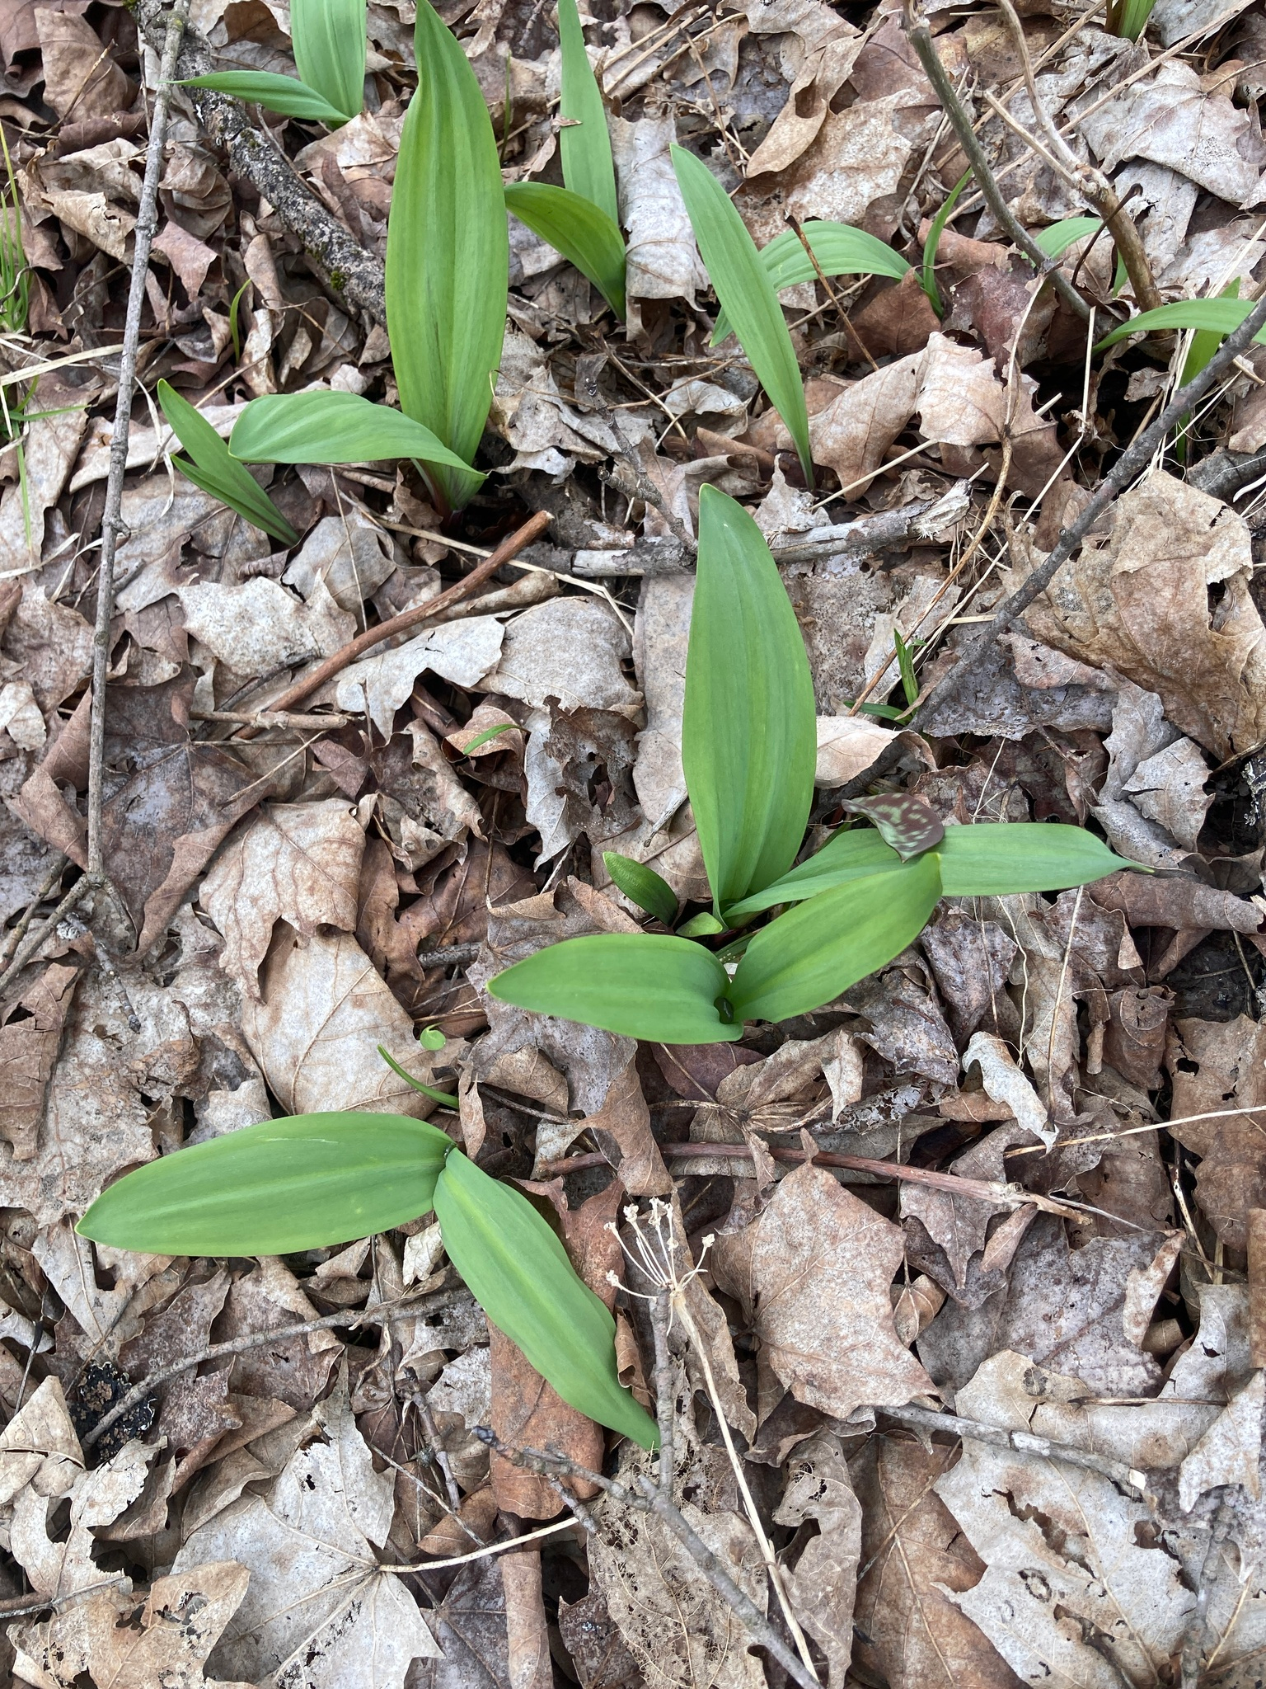
Where sustainability applies in FOSS:
Projects
Developers
Communities
Businesses
Academia
Ecosystems
Environment
Ramps https://www.inaturalist.org/observations/208351861
Notes:
Let's go over these in depth, to see how it is applied.

Slide 11
Sustain: FOSS Projects
Growth
Diversity
Funding

Slide 12
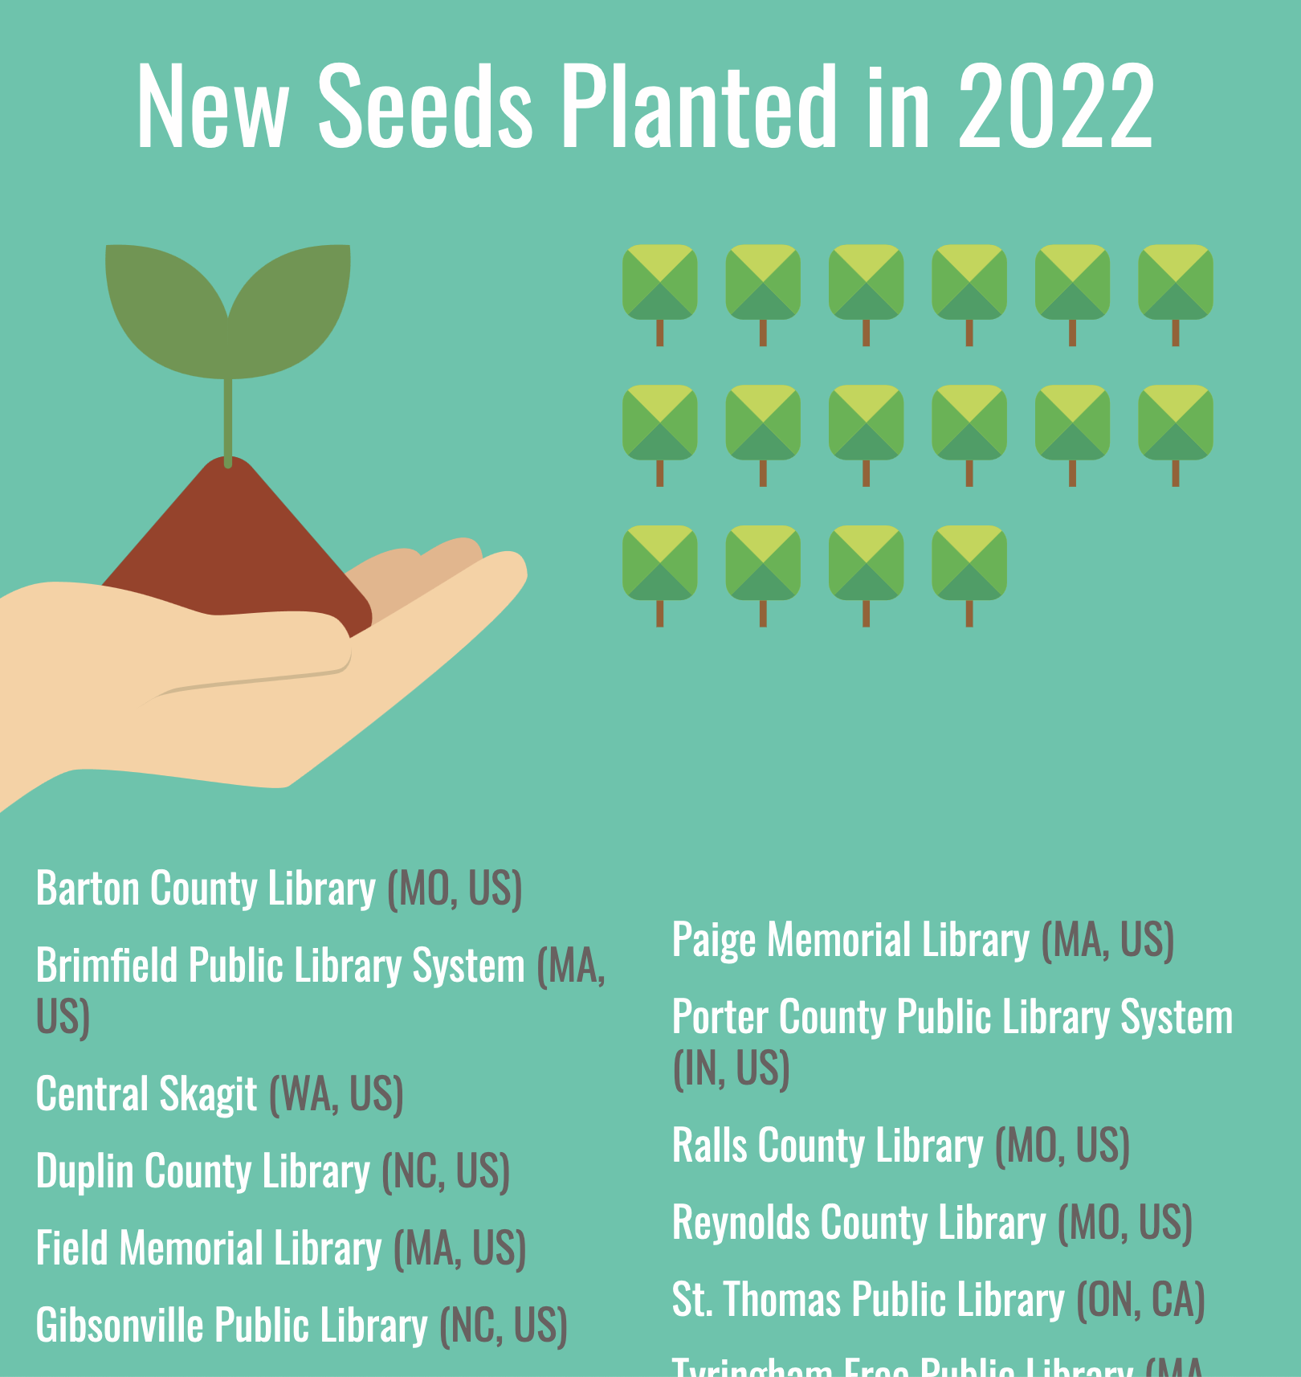
Sustain: FOSS Projects
Growth
More in than out
Pathways to maintainership
Product management and design planning
Goal: capturing market share of attention
https://evergreen-ils.org/wp-content/uploads/2023/12/Annual%20Report%202022.pdf

Slide 13
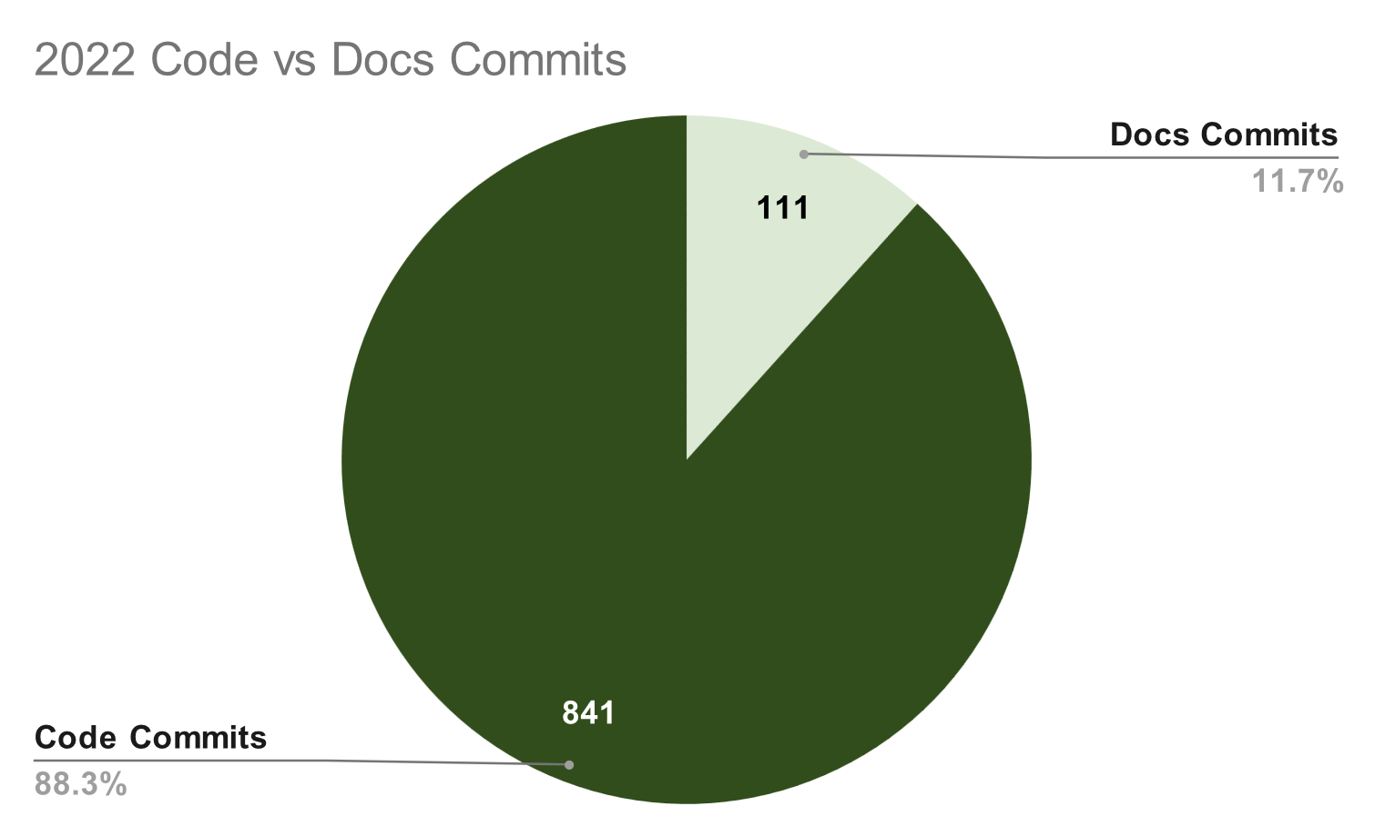
Sustain: FOSS Projects
Diversity
Welcoming community spaces
CoCs
Documentation
Moderation
Mentoring
Goal: towards some ethical destination
https://evergreen-ils.org/wp-content/uploads/2023/12/Annual%20Report%202022.pdf

Slide 14
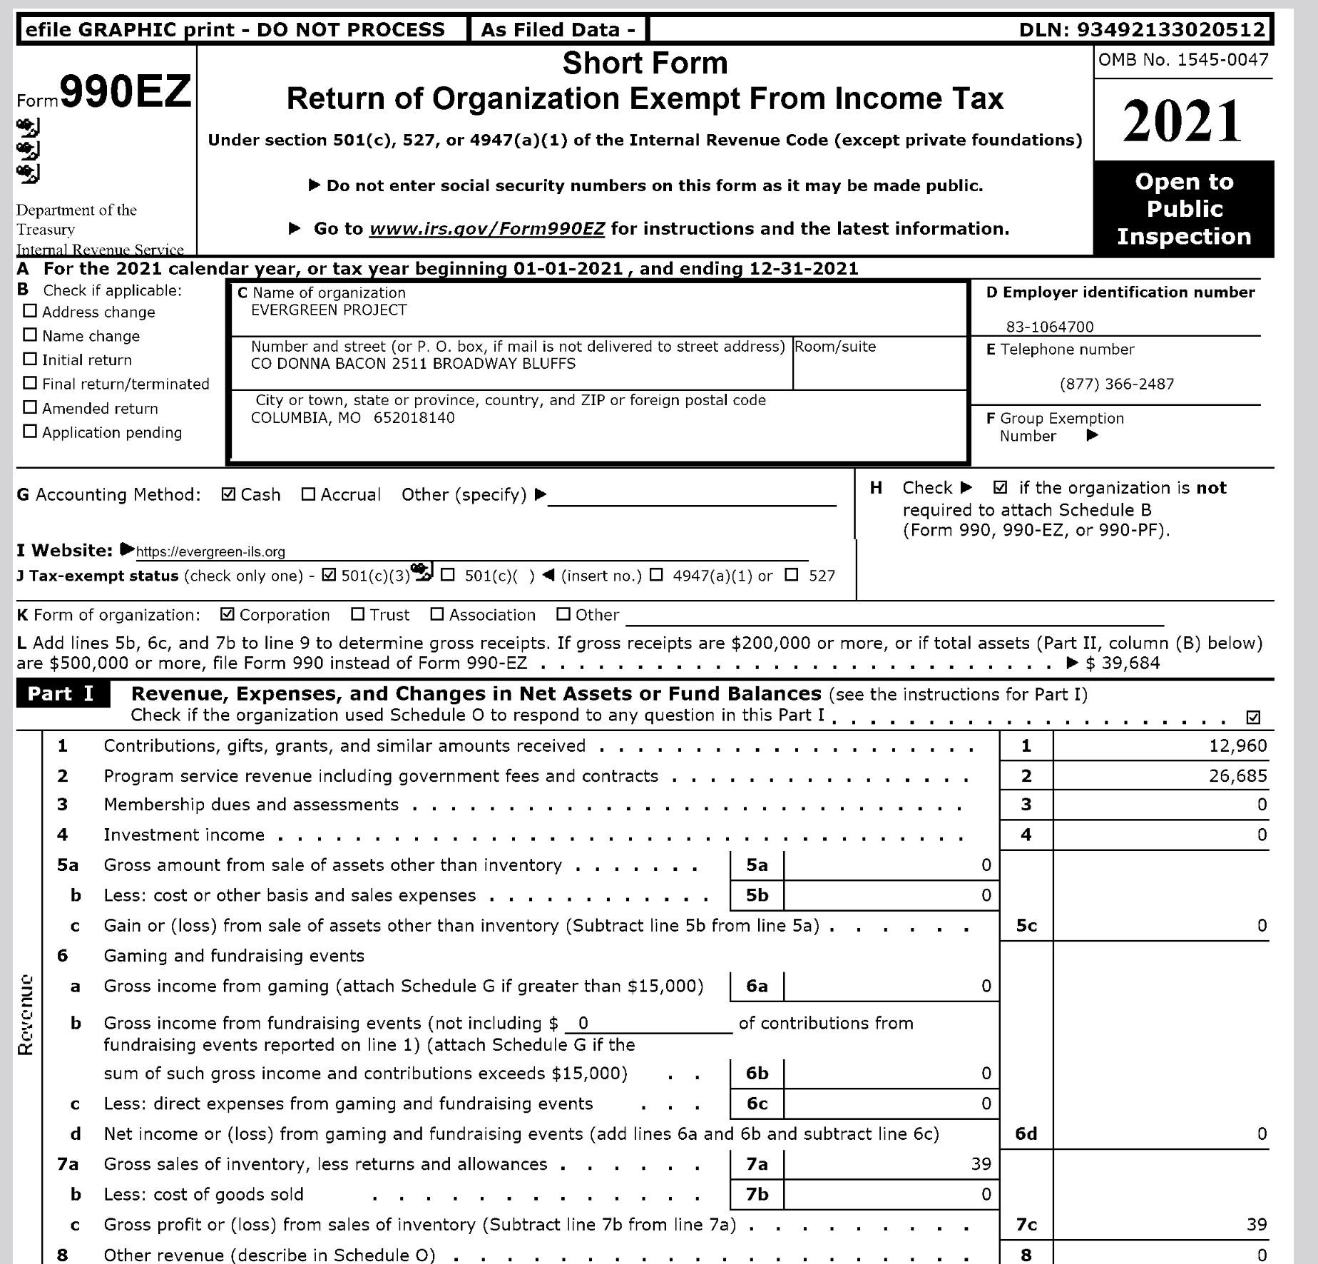
Sustain: FOSS Projects
Funding
Funding for the project costs
Funding for the core maintainers
Lifestyle funding
Funding for all contributors
Non-fiscal sponsorships

Slide 15
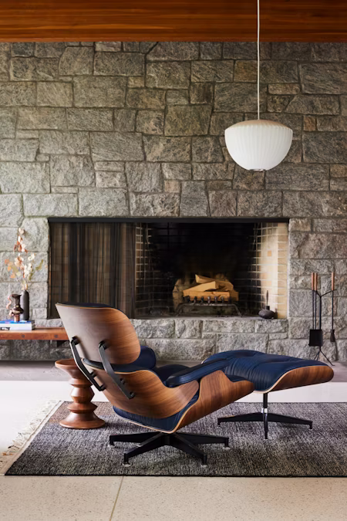
Sustain: FOSS Developers
Satisfaction
Career trajectories
Mentoring
Funds and recognition
Avoiding burnout
https://store.hermanmiller.com

Slide 16
Sustain: FOSS Communities
Not always tied to a project
Functionally similar to what we talked about above
But at scale.
https://store.hermanmiller.com

Slide 17
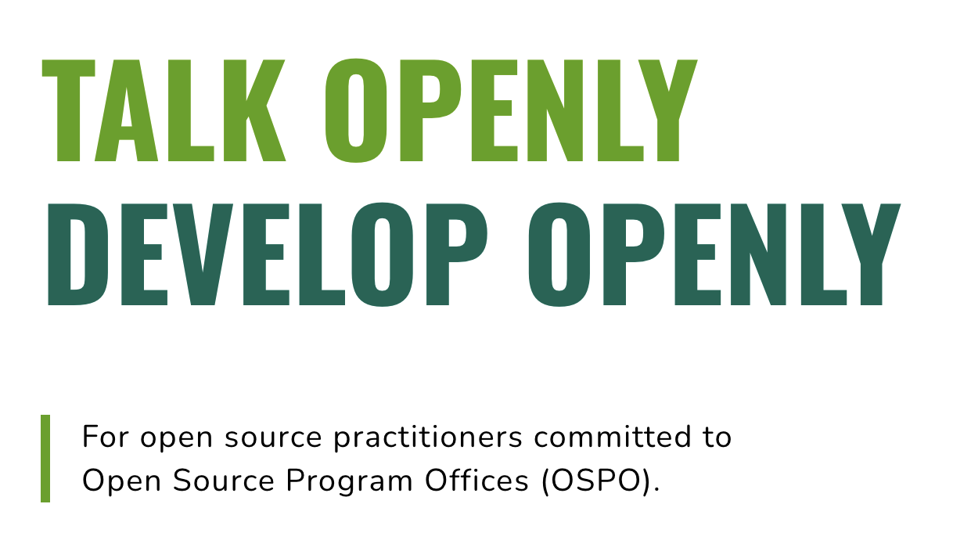
Sustain: FOSS Businesses and Corporate
Focus: a bottom line
Not pushing OSS onto your employee's private time
Having advocates and marketing inside the company for open source
OSPOs
"Collaboration"
https://todogroup.org/

Slide 18

Sustain: FOSS Academia
Not quite the same as industry or most open source
Reproducibility
Citations and altmetrics
The project- or funding-based cycles of OSS in academia
The student-graduation cycle of academia
Where support comes from in the institution
https://curioss.org

Slide 19
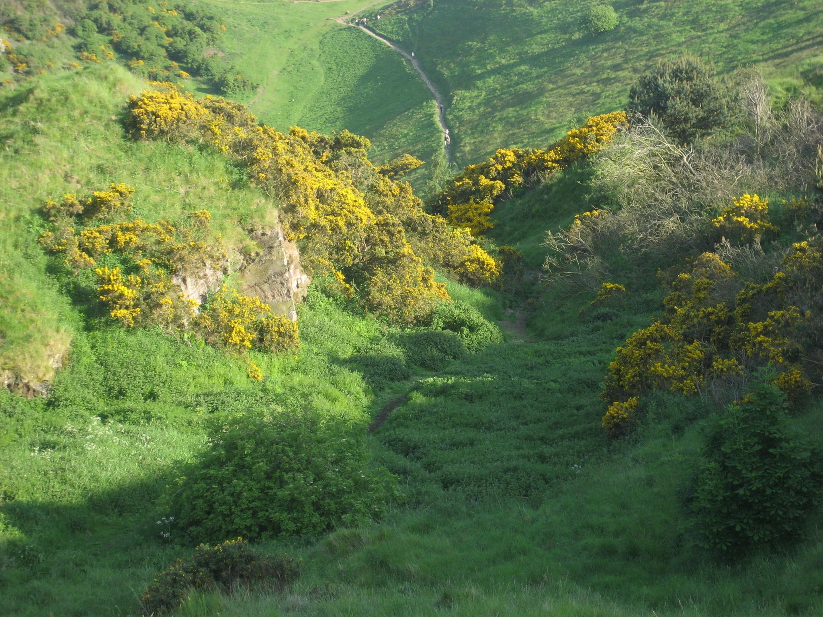
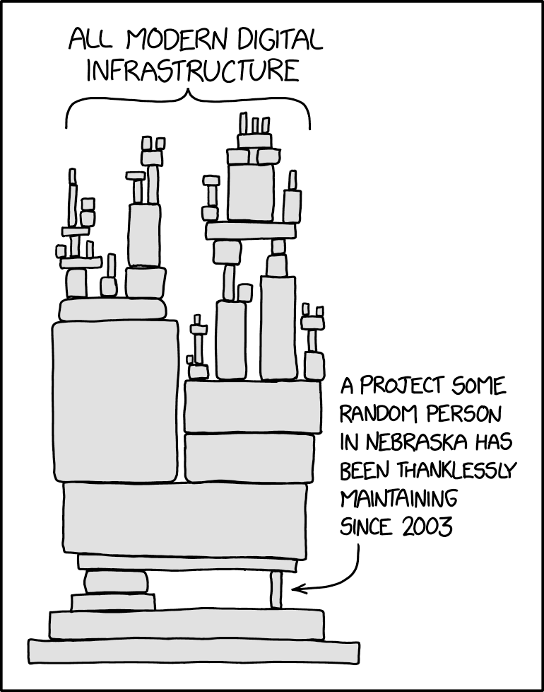
Sustain: FOSS Ecosystem
Funding maintainers for their work
Security and supply chains
The "digital commons"
Gorse https://www.inaturalist.org/observations/65500592
https://xkcd.com/2347/

Slide 20

Sustain: FOSS Ecosystem
Legal sustainability and licenses
Stopping proliferation
Open washing
Patent issues
AI + open source
Taxation and infrastructural funding
The CRA and their ilk
https://www.sovereigntechfund.de/

Slide 21
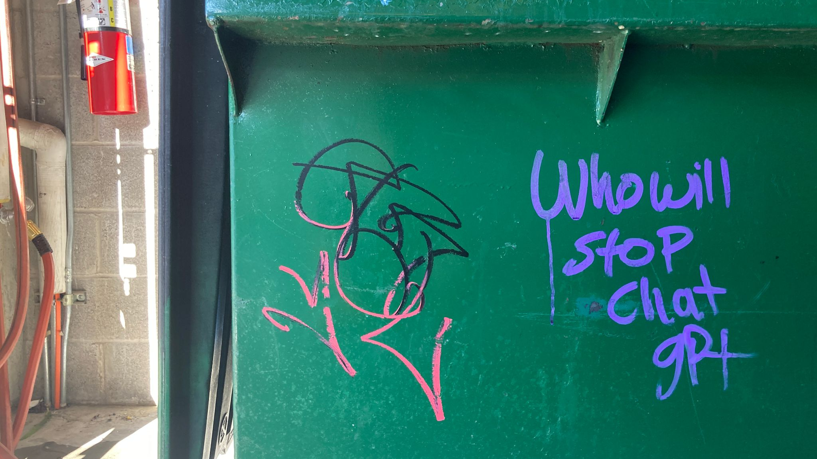
Sustain: FOSS Ecosystem

Slide 22
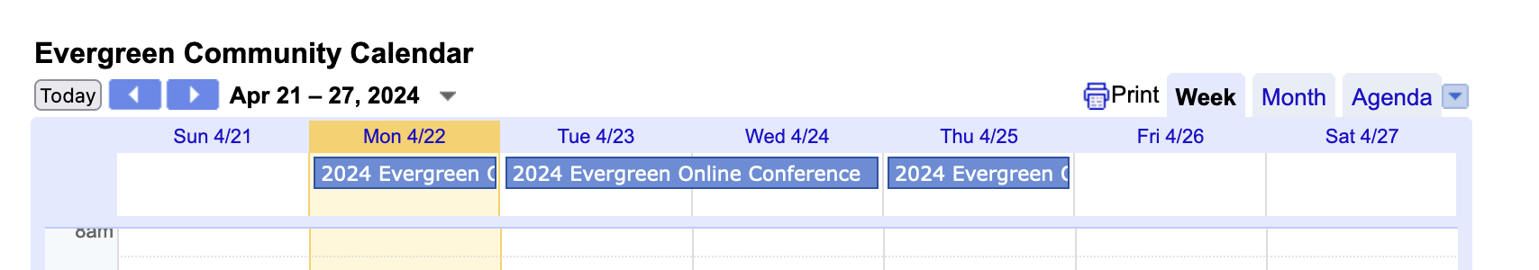
Sustain: FOSS & Environment
Open source hardware
Carbon-neutral data storage centers
Reducing server costs
Not using bitcoin
Avoiding the conference trap
https://evergreen-ils.org/communicate/calendar/

Slide 23
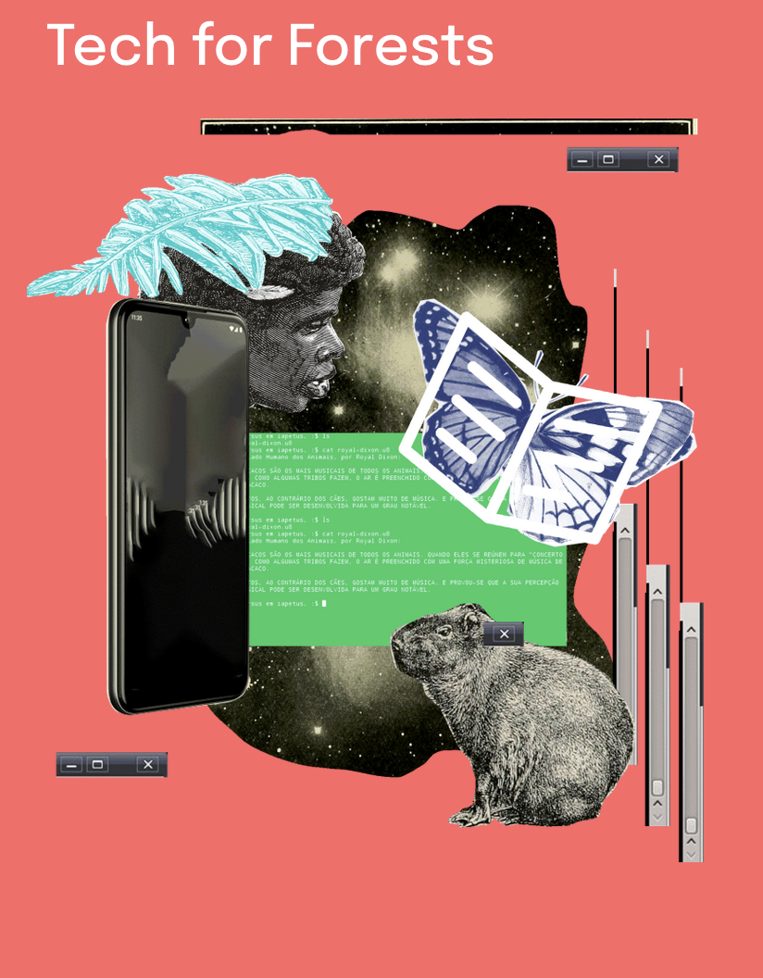
Sustain: FOSS & the whole environment
Tech for environmental activists
Tech for environmental studies
Use of tech for the planet as a whole
https://techforforests.org/

Slide 24
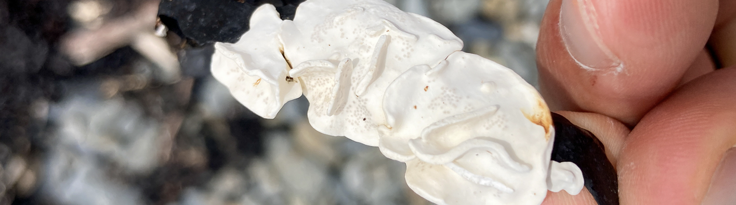
Sustain???
At this point, it should be clear that "sustainability" is being overused and is somewhat semantically bleached.
Lithophyllum carpophylli https://www.inaturalist.org/observations/143377222

Slide 25
When you see "Sustain", ask:
For what?
For whom?
For how long?
From what original state?
Why this term?

Slide 26
Sustain covers all manner of sins.
Was it healthy to begin with?
Were people treated well?
Were practices ethical?
What about all of the stuff we talked about above?

Slide 27
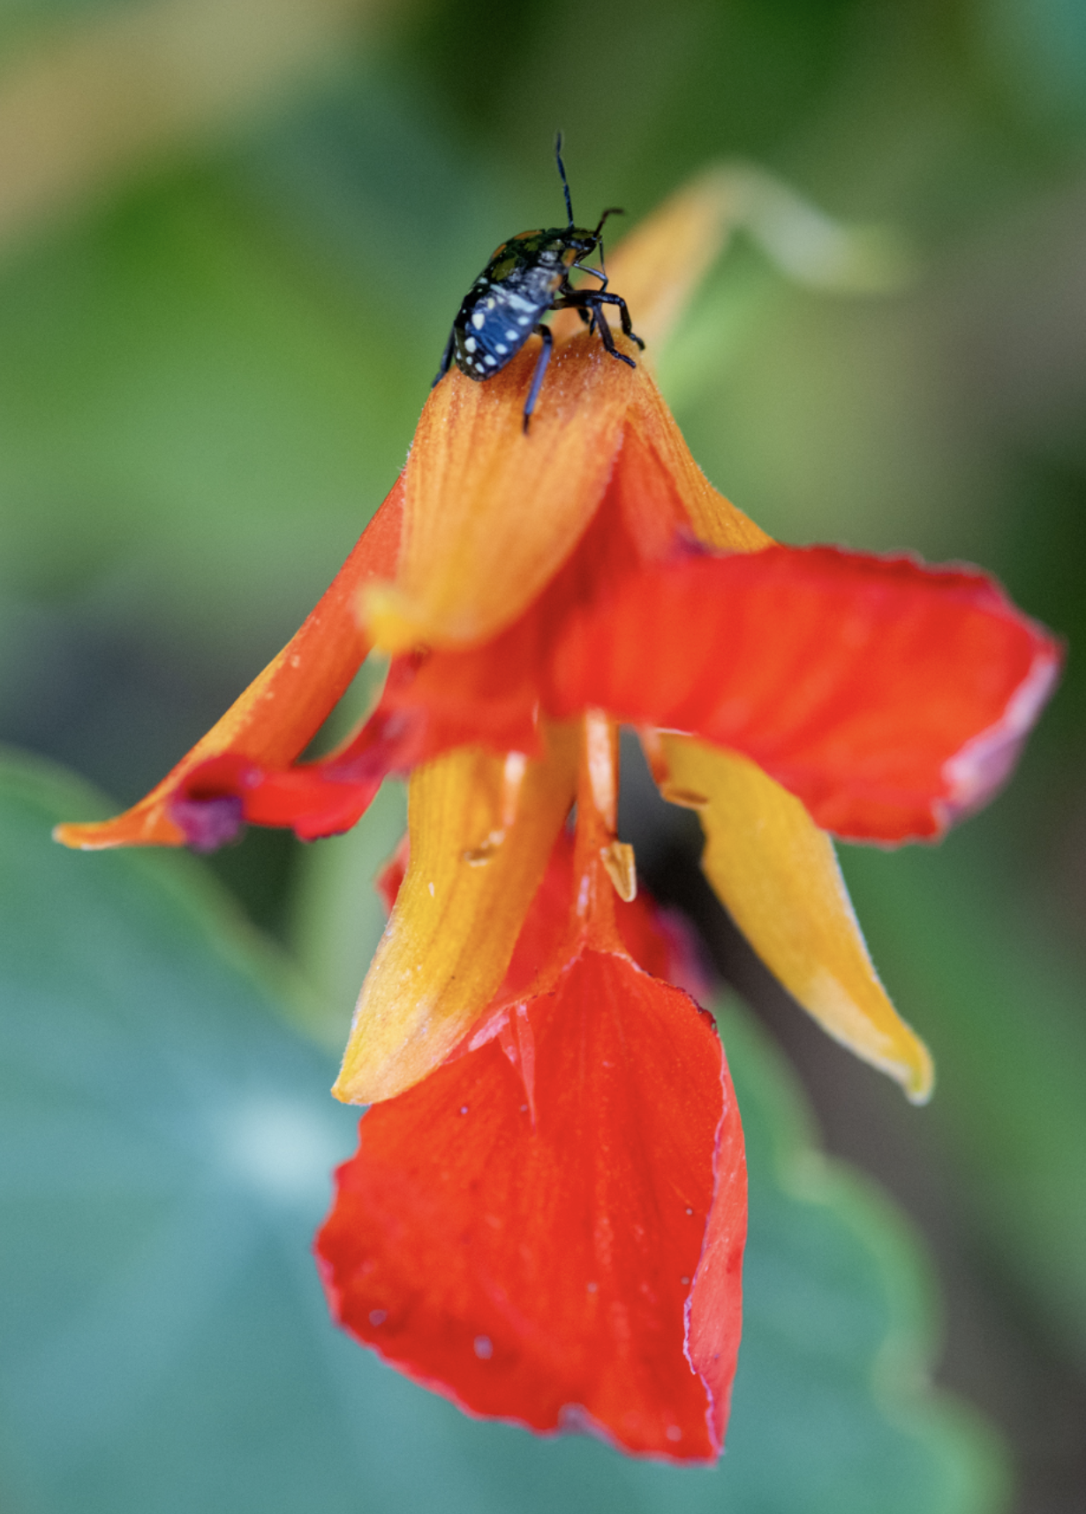
What does "sustain" mean, anyway?
Temporal term
It ignores:
End-of-life cycles for software projects
End-of-life cycles for software ecosystems
Boom-and-bust cycles for fads
Garden Nasturtium https://www.inaturalist.org/observations/208389735

Slide 28
"Sustain" fails to recognize:
Current achievements
Creative output
The bigger picture.

Slide 29
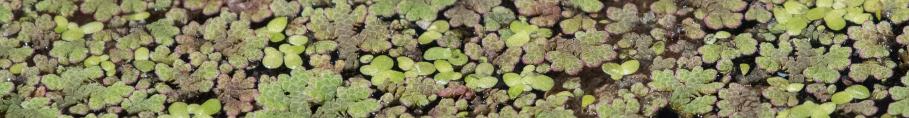
The bigger picture:
Life on earth is dying.
Things are mildly OK for some humans right now.
The heat death of the universe.
Red Azolla https://www.inaturalist.org/observations/143949050

Slide 30
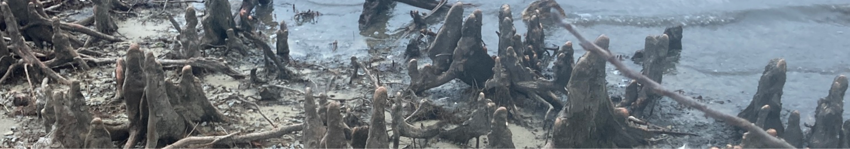
The bigger picture:
Every piece of software you love will die and be forgotten.
Baldcypress https://www.inaturalist.org/observations/146574140

Slide 31

But wait… what does open mean, here?
Source: Midjourney

Slide 32
Let's define it for open source:
License
or
Methods
Notes:
Functionally meaningful on two axes.

Slide 33

Let's define it for open source:
License
Methods

Slide 34

What about?

Slide 35
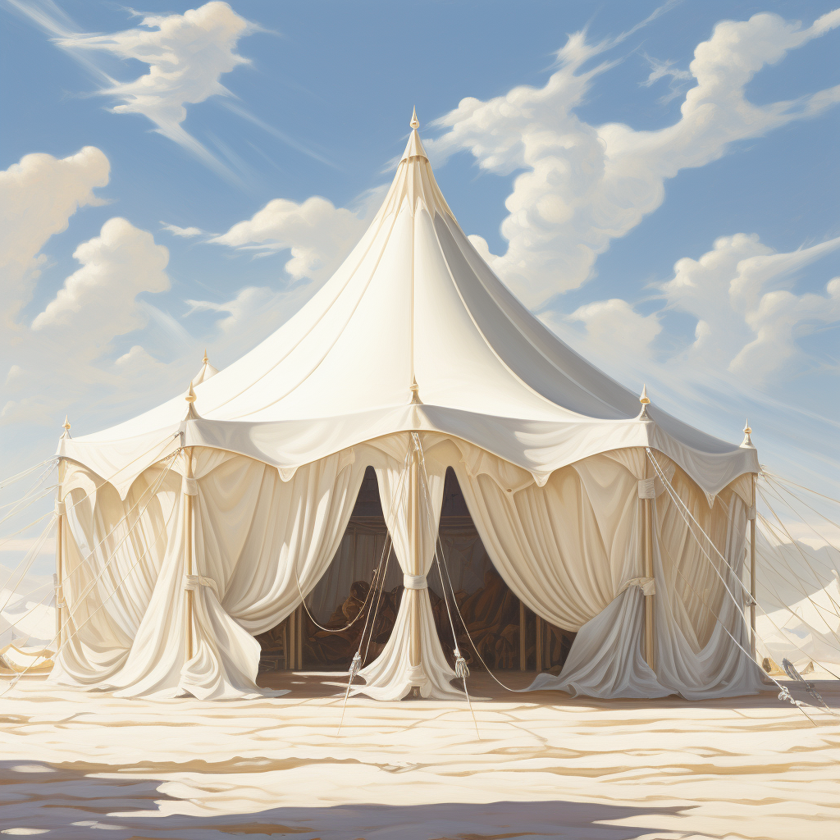
What about?
Open Source*
Source: Midjourney
Notes:
Among many other types of open, including RIT's Open Work

Slide 36
Using this definition:
Methods
"Open source is a verb, not a noun."
Notes:
Not entirely useful, because it obscures differences in action, but it's clear what it's saying - continued effort.

Slide 37

So what is open, then?
Antitrust maneuvering
Open washing
Avoiding sign-off from
bureaucrats.
Over-the-wall throwing
Source: Midjourney

Slide 38
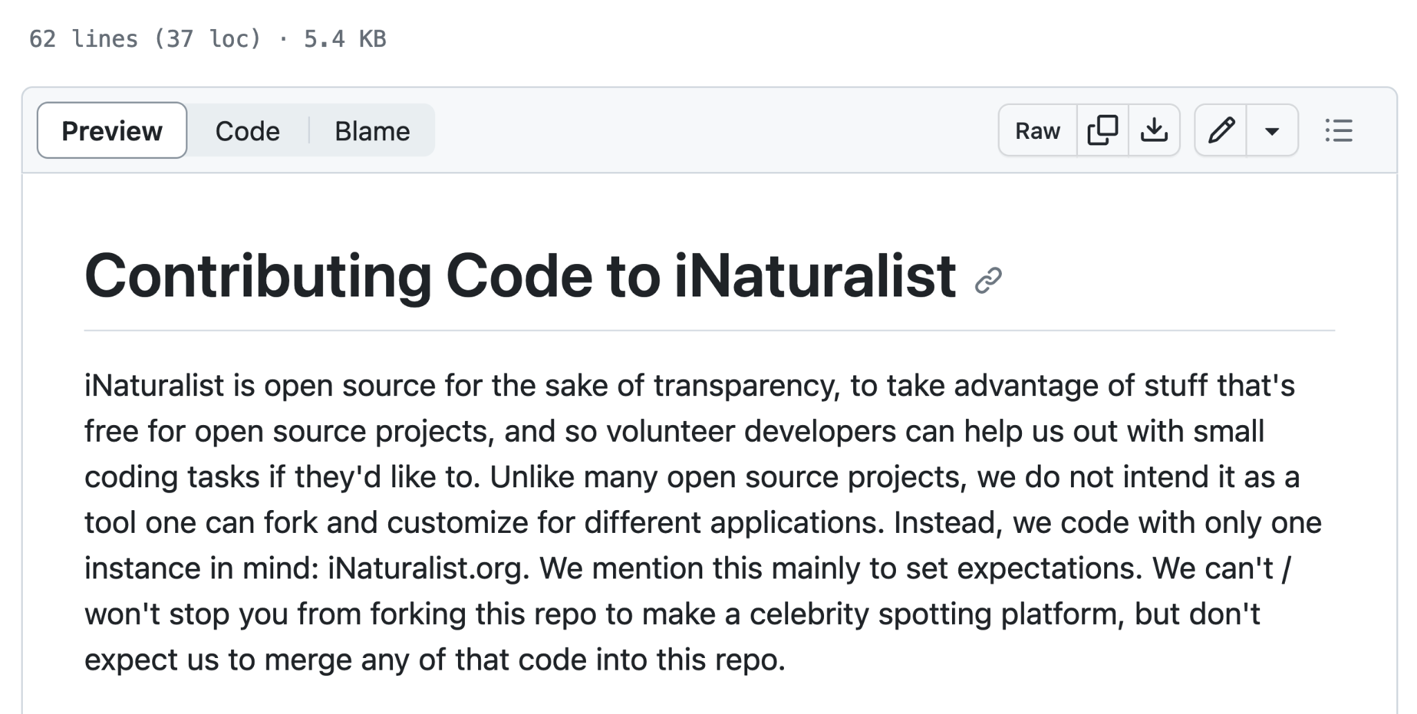
Nuance
https://github.com/inaturalist/inaturalist/blob/main/CONTRIBUTING.md

Slide 39
Nuance
Open source?
Sure!
https://github.com/inaturalist/inaturalist/blob/main/CONTRIBUTING.md

Slide 40
Conclusion
Not all open source communities are the same.

Slide 41
Conclusion
Not all open source is the same.

Slide 42

Conclusion
Not all open is the same.
"Open" from Midjourney

Slide 43
But…
Is this project OSI approved: Yes or No.
Is it Open Source: Well…
Notes:
Why is one binary? Why isn't the other?

Slide 44
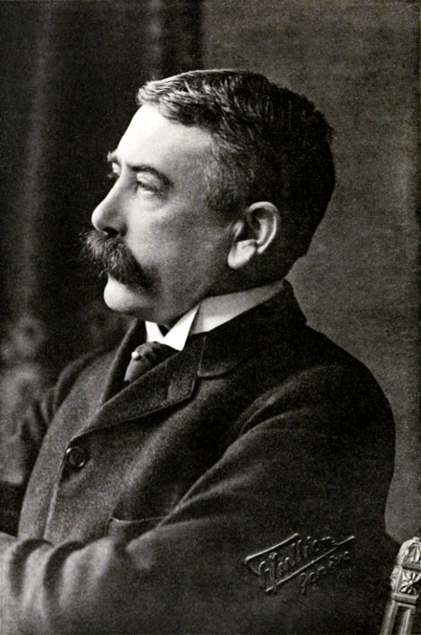
Because this guy
Ferdinand Saussure
Inventor of semiotics
Denotation
Connotation
Source: Wikipedia
Notes:
Denotation = the thing in the world. Connotation : all the stuff around it that we add.

Slide 45
Because this guy
Ferdinand Saussure
Inventor of semiotics
Denotation => OSI
Connotation => Open source more broadly
Source: Wikipedia

Slide 46
Abstractions
Depend upon shared context, values, and delegated authority
Useful for talking to each each other
https://en.wikipedia.org/wiki/Scrabble#/media/File:Scrabble_game_in_progress.jpg

Slide 47
So, what matters?
To ennoble human nature
To act cooperatively and with an egalitarian mindset
To make life more meaningful
To mitigate and reduce pain and suffering.

Slide 48
Instead of saying "Sustain!", ask:
Does my personal development life / project / ecosystem / business contribute to the happiness of myself and others?
Does it recognize, validate, and protect basic living rights?
Does it reduce harm?
Does it increase capacity for wonder, awe, and joy?

Slide 49
What gets measured is what is valued.
How are you measuring joy?
How are you measuring wonder?
How are you measuring impact on real lives?
How are you working towards improving those metrics?

Slide 50
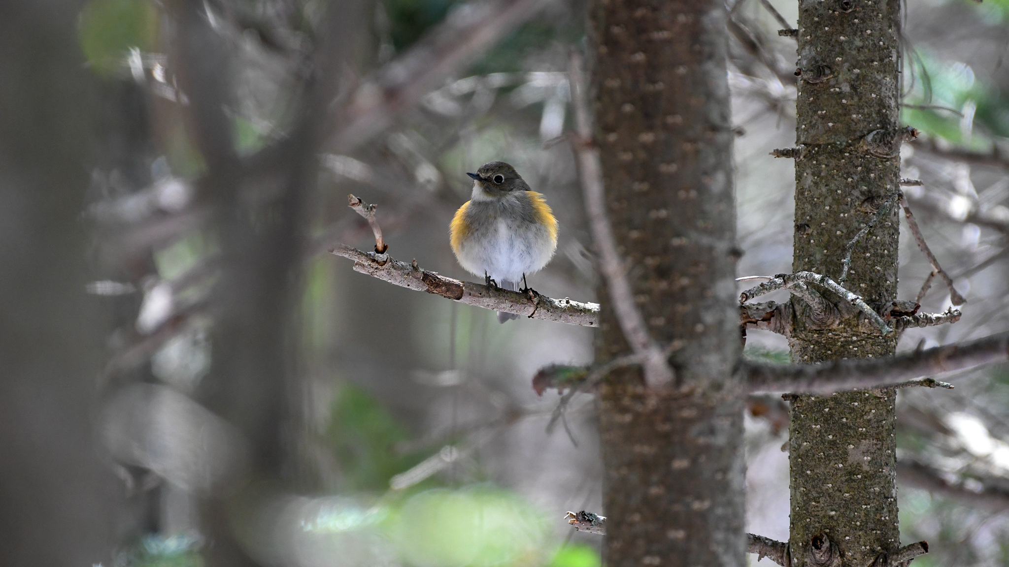
Thanks.
Questions?
Unknown Fir https://www.inaturalist.org/observations/193983218
https://podcast.sustainoss.org – http://richard.social

